Slide 1

Team 1

Slide 2
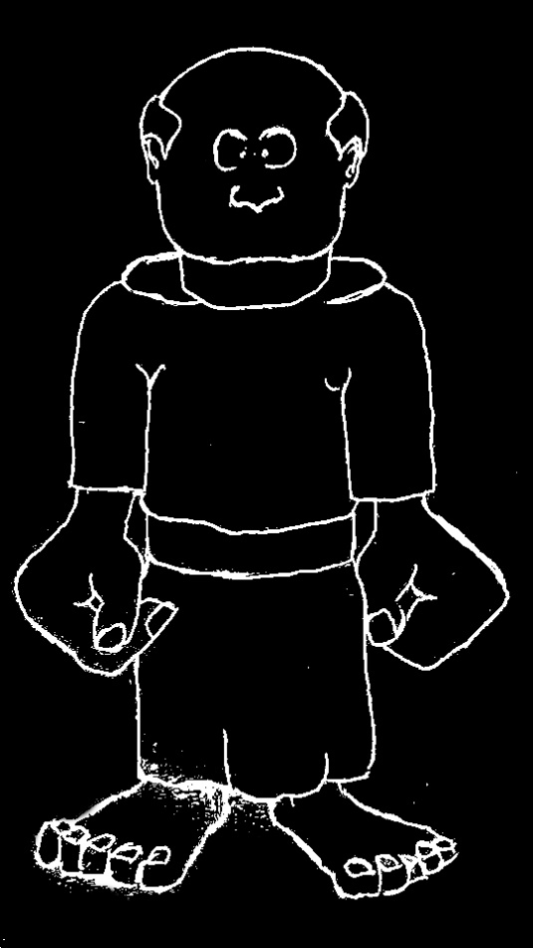
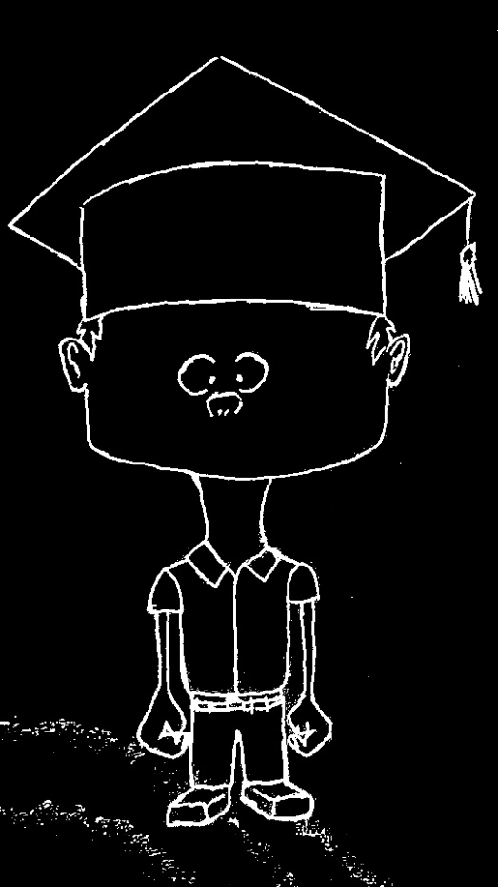
Quick Summary
Religionist
Scientist

Slide 3
Quick Summary
Wonder R
Wonder S
R
R
S
S
R
S
R
R
R
S
R
R
R
S
S
S
R

Slide 4
Quick Summary
Wonder R
Wonder S
R
R
S
S
R
S
R
R
R
S
R
R
R
S
S
S
R

Slide 5
Quick Summary
Wonder R
Wonder S
R
R
S
S
R
S
R
R
R
S
R
R
R
S
S
S
R

Slide 6
Quick Summary
Wonder R
Wonder S
R
R
S
S
S
R
R
R
R
S
R
R
R
S
S
S
R

Slide 7
Quick Summary
Wonder R
Wonder S
R
R
S
S
S
R
R
R
R
S
R
R
R
S
S
S
R

Slide 8
Quick Summary
Wonder R
Wonder S
R
R
S
S
R
S
R
R
R
S
R
R
R
S
S
S
R

Slide 9
Quick Summary
Wonder R
Wonder S
R
R
S
S
R
S
R
R
R
S
R
R
R
S
S
S
R

Slide 10
Quick Summary
Wonder R
Wonder S
R
R
S
S
R
R
R
R
R
S
R
R
R
S
S
S
R

Slide 11
Quick Summary
Wonder R
Wonder S
R
R
S
S
R
R
R
R
R
S
R
R
R
S
S
S
R

Slide 12
Demo

